Slide 1



Data science & Visualization with PowerBI

Slide 2

What is Visualization?
  Data visualization is a field in data analysis that deals with visual representation of data.
  It graphically plots data and is an effective way to communicate inferences from data.
  we can get a visual summary of our data. With pictures, maps and graphs, the human mind has an easier time processing and understanding any given data

Slide 3


Benefits of Visualization
  Simplifies complex data
  Reveals patterns and trends
  Increases accessibility
  Real-time monitoring
  Identify areas that need attention or improvement
  Enhances storytelling
  Increases productivity

Slide 4



DV in Python
Python offers several plotting libraries, namely
Matplotlib
Seaborn

Slide 5







  Matplot
Customizable
Matplot is the python libraries used for DV
they have inbuild module for plotting different graphs
pair well with pandas and numpy for EDA
Works
dataset and arrays
Used
plot-line,bar,etc

Slide 6


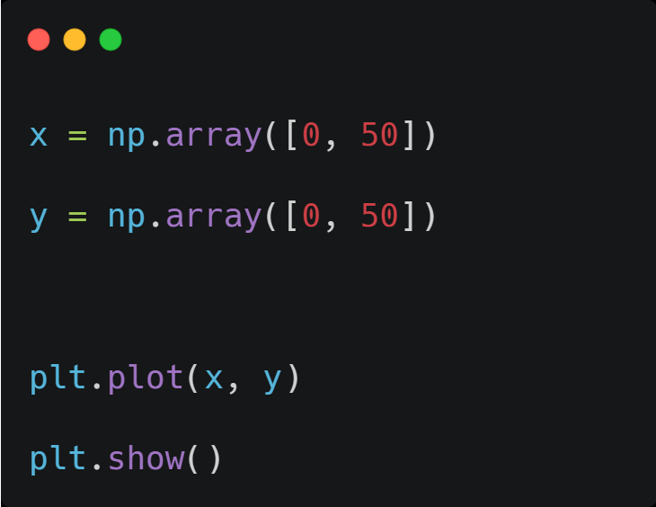
Line Plot

Slide 7
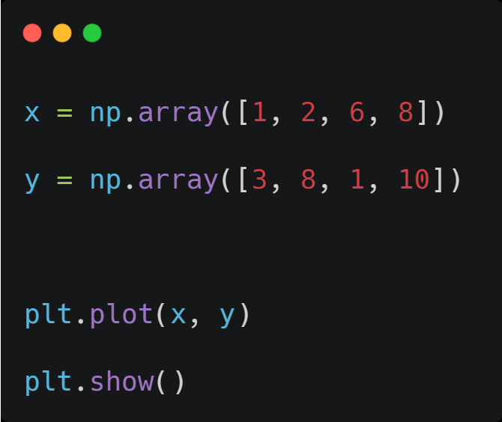
Draw multiple line

Slide 8
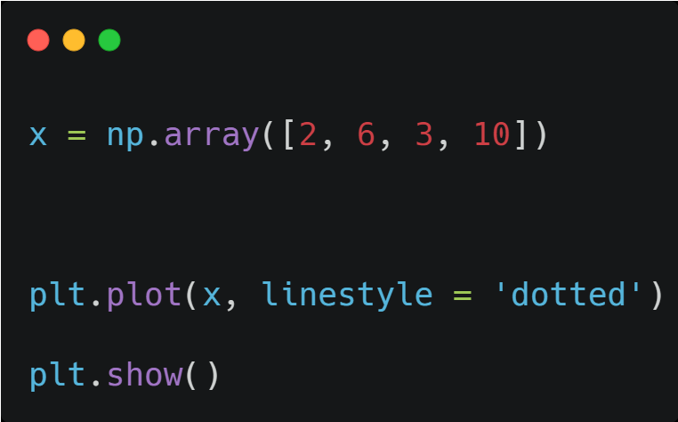
line style

Slide 9
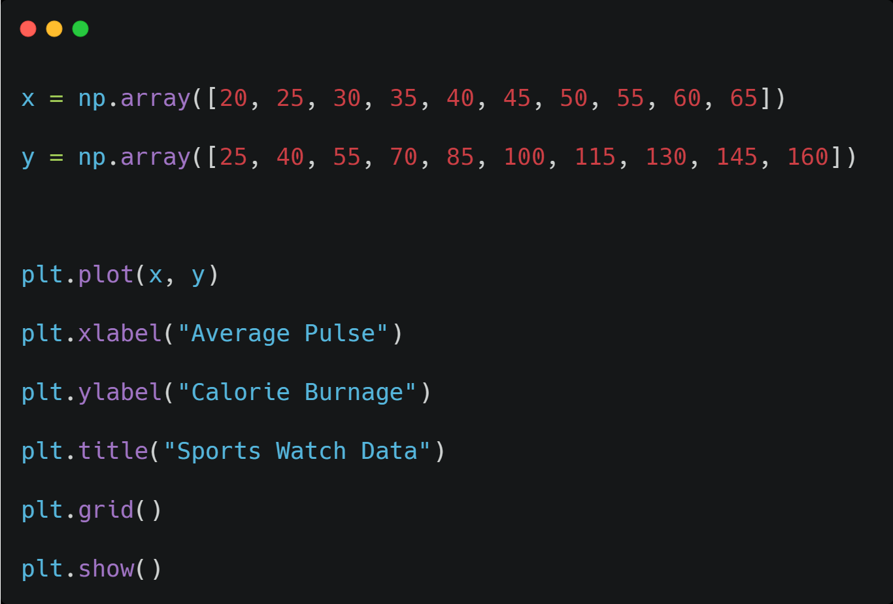
Labels, Title, Grid

Slide 10
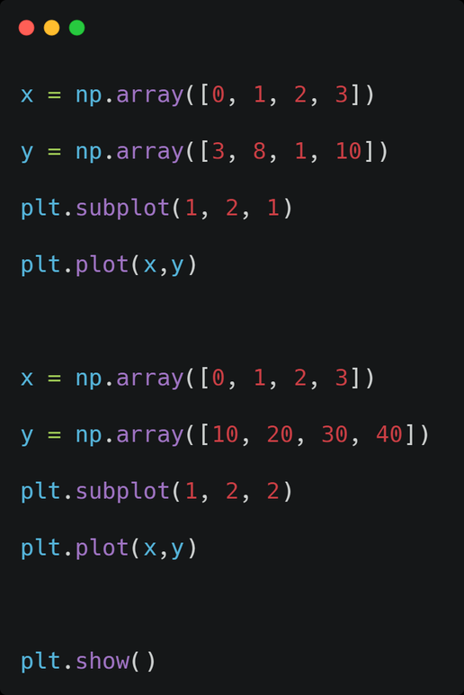
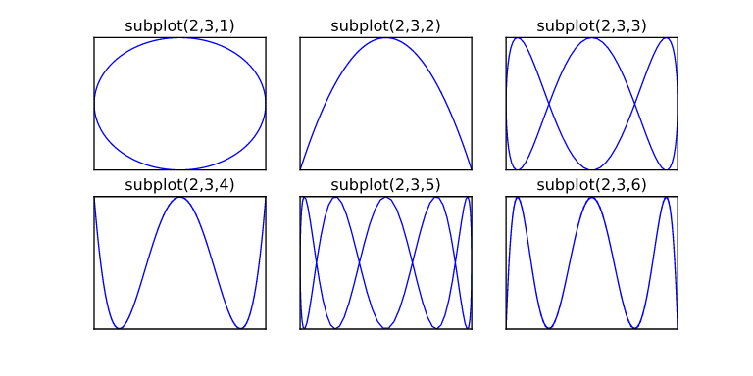
Subplots

Slide 11
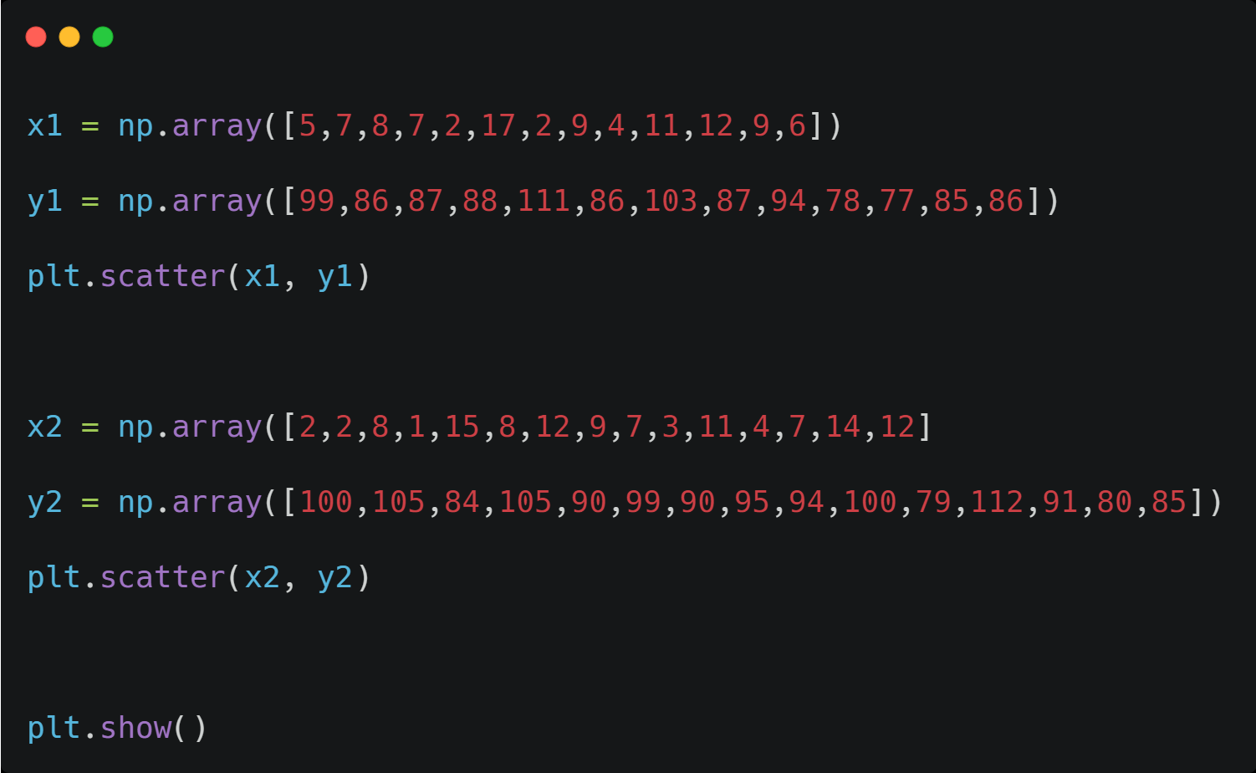
Scatter plot

Slide 12
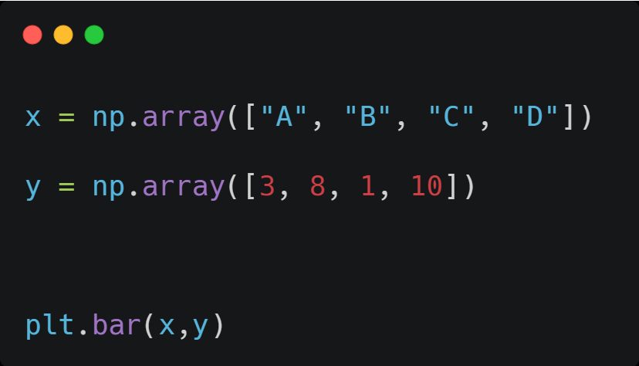
Bar plot

Slide 13
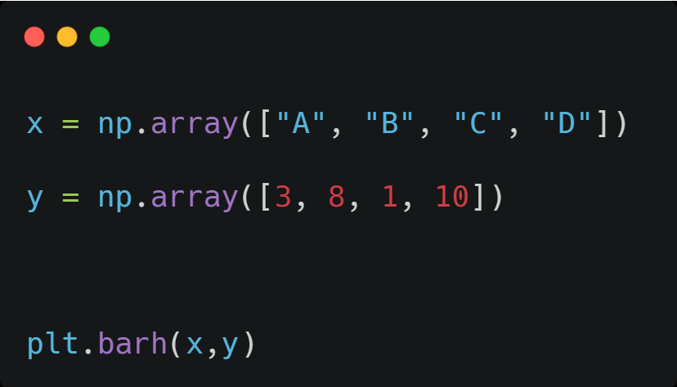
Horizontal bars

Slide 14
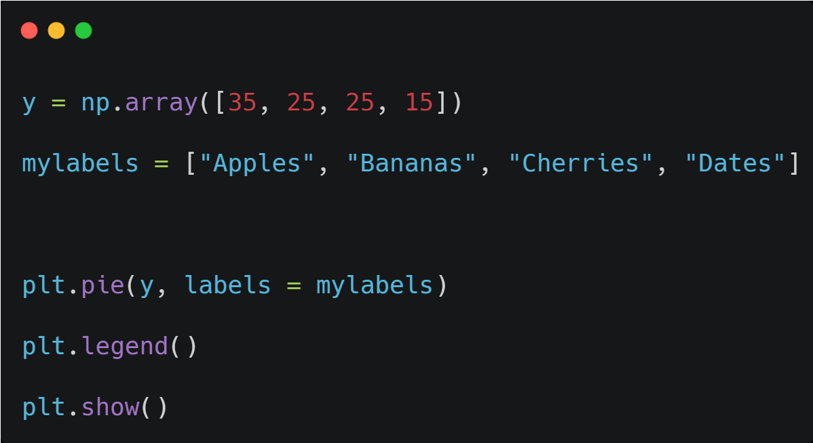
Pie chart

Slide 15
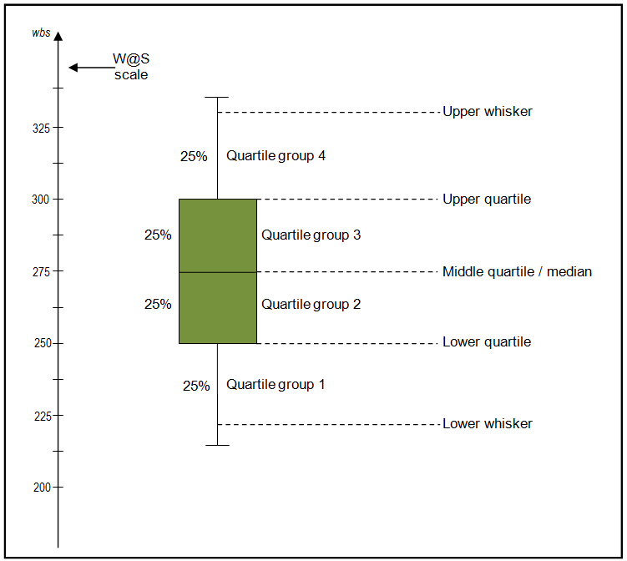

Box plot

Slide 16


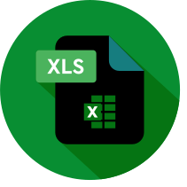


Python
R script
Excel
Tableau
Power BI

Slide 17
Introduction to Power BI
  Business analysis service provided by microsoft that lets you visualize your data and share insights
  It coverts data into interactive mode and usefull insights , visualize the data.
  It allows you to view , analyse and visualize huge quantities of data that cannot opened in excel
  PowerBI allows you to get insight from data and turn insights into actions to take data driven business decision

Slide 18







Architecture of Power BI
powerbi service
mobile view
powerbi gate way
Data sources
powerbi desktop
desktopview

Slide 19
Power BI Versions
  Power BI Free: Available for individual use. It includes basic features like creating reports and dashboards, but has limited sharing capabilities.
  Power BI Pro: A paid version for collaboration and sharing, which includes additional features such as the ability to share content and collaborate with others.
  Power BI Premium: A more advanced version, designed for larger organizations, offering dedicated cloud resources, better performance, and advanced data models.

Slide 20
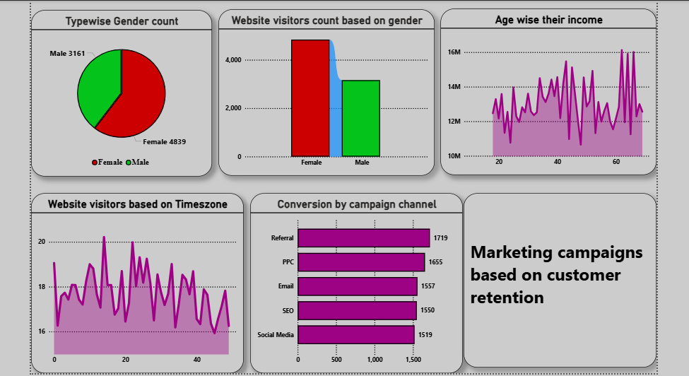

Slide 21


